Slide 1


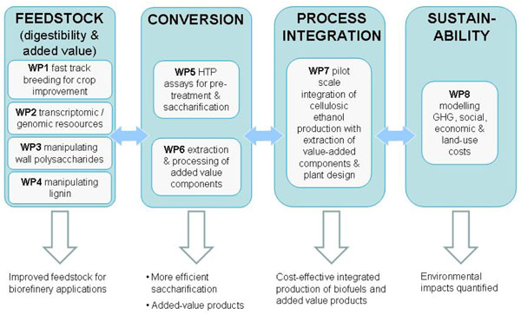
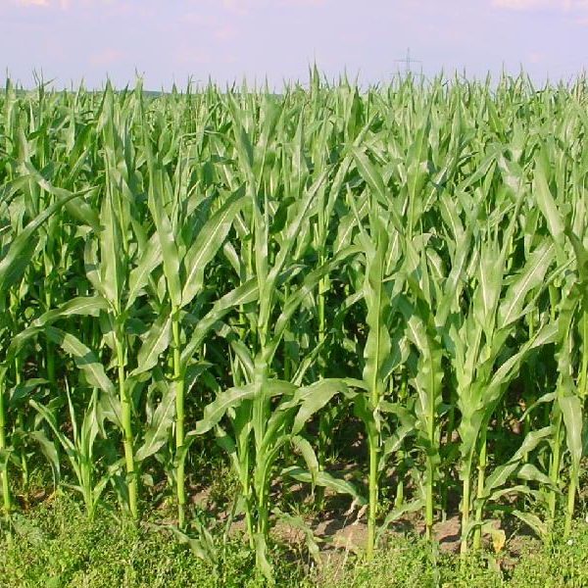
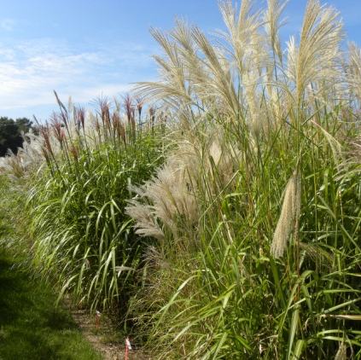
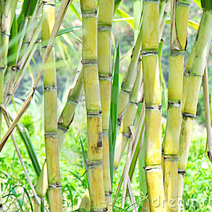

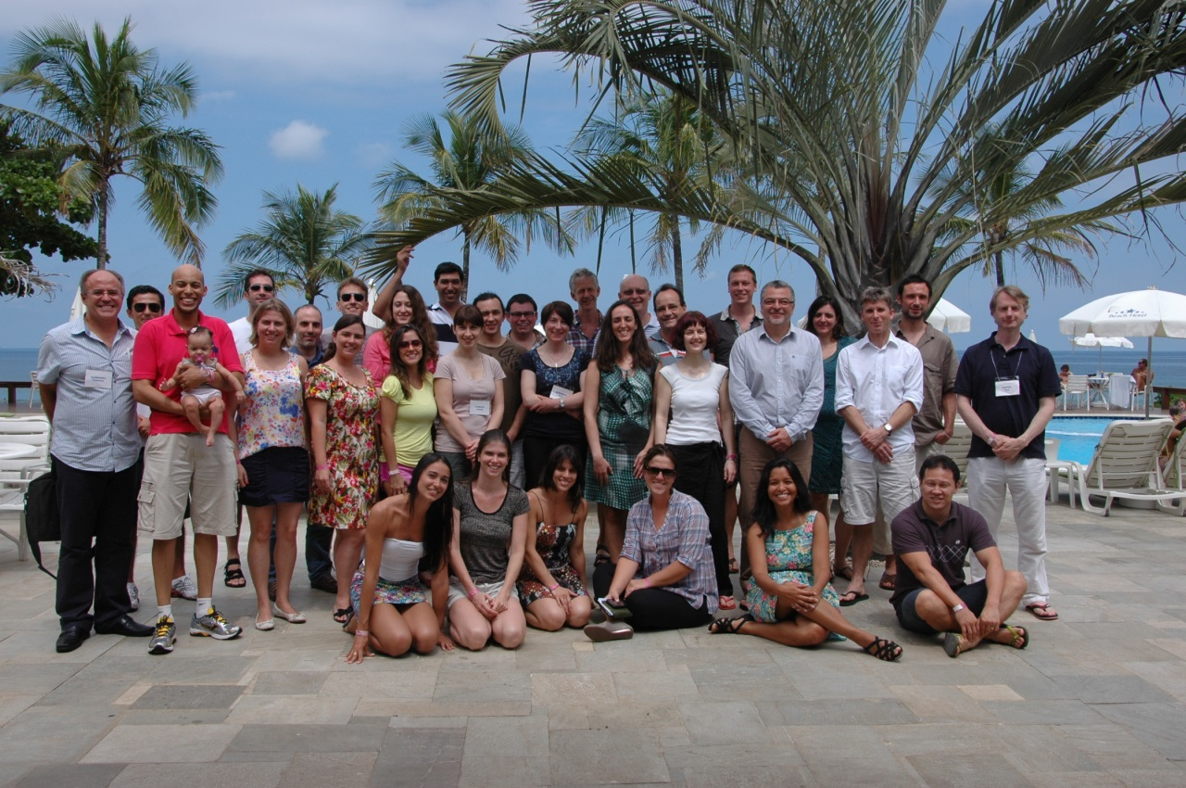


SUNLIBB
Sustainable Liquid Biofuels from Biomass Biorefining
What is SUNLIBB?
SUNLIBB is an EU-funded consortium project, working to overcome technical barriers to second-generation bioethanol production. SUNLIBB brings together key researchers and industrial innovators working in areas such as feedstock improvement, pre-treatment and saccharification, generation of added-value products (especially from lignin) and fermentation. The work is focused on 3 closely-related grasses; maize, miscanthus and sugarcane, which are major bioenergy crops in Europe and Brazil. The project collaborates closely with a sister consortium in Brazil (CeProBIO). This cooperation provides an opportunity for some of the best researchers in our respective regions to work together on a globally important issue.
Background
Humanity faces a dilemma: how to escape our dependence on fossil fuels and reduce greenhouse gas (GHG) emissions, without further exacerbating the environmental impacts of agriculture. This issue faces all of us, because GHG emissions that are produced locally have global impacts. Also, we operate in a global economy, where commodities such as biofuels are traded on the world stage.
First-generation or conventional biofuels are made from sugar, starch or vegetable oil and have attracted criticism because their production is energy intensive and may increase food prices. In comparison, second-generation biofuels can be made from agricultural residues or waste, which otherwise may be costly to dispose of. Second-generation biofuels clearly have the potential to deliver considerable benefits, by increasing the environmental sustainability of bioenergy production.
Lignocellulosic residues from temperate EU crops such as maize, tropical Brazilian crops such as sugarcane and dedicated biomass crops such as miscanthus are all potential feedstocks for second-generation bioethanol production. However, it is hard to extract useful sugars from this woody or fibrous biomass, because of the presence of complex carbohydrates such as lignin, hemicellulose and cellulose, which lock the useful sugars in. The sugars have to be released using enzymes or pre-treatments before they can be fermented to make bioethanol. As a result, several technical challenges need to be overcome before second-generation biofuels could be produced in an economically competitive manner.
The aim of the SUNLIBB-CeProBIO project is to combine European and Brazilian research strengths to open the way for cost-competitive lignocellulosic bioethanol production, whilst ensuring that this also brings about the anticipated environmental benefits. The project integrates Brazilian expertise in sugarcane breeding and bioethanol process engineering with EU expertise in genomics, plant science and green chemistry.
Project Overview
Maize, miscanthus and sugarcane
Closely-related grasses, all
with C4 metabolism.
Knowledge generated in
one species can be
transferred to the others.
Objectives
The SUNLIBB programme of work aims to:
Improve the feedstock quality of lignocellulose in biofuels crops in order to allow truly cost-effective ethanol production. This will be achieved using modern crop breeding approaches and cutting-edge plant cell wall research, to introduce improved digestibility traits to elite varieties, thus reducing the high costs associated with biomass conversion. To do this, we are incorporating dedicated gene identification programs that will discover genes for better quality polysaccharide content, improved digestibility and lignin that is easier to break down.
Add value to the overall process of conversion in biomass biorefining, by upgrading residues and by-products and producing other value streams from the feedstock, in addition to bioethanol. We are developing technologies for the extraction of valuable materials such as waxes and oligosaccharides, as well as carrying out novel underpinning science to allow valuable materials to be generated from the breakdown products of lignin. These processes have been developed at laboratory scale and are being tested in pilot processing plants.
Improve the conversion process by which we produce sugars for fermentation. We aim to do this using our improved feedstock with unique combinations of pre-treatments and new enzymes that are being produced in Europe and Brazil for the biochemical conversion of lignocellulosic material.
Develop integrated processes that capture maximum value from lignocellulosic biomass, by integrating a range of product streams in addition to bioethanol. We are bringing improved feedstock, added value product extractions and improved saccharification and fermentation combinations together in pilot biorefineries in Europe and Brazil. This includes in-silico optimisation of energy balances, design of the plant, cost evaluation, exploration of efficient co-generation and reduced energy use for steam and cooling operations, as well as development of new thermo-chemical pre-treatments.
Ensure that the new processes developed fulfil sustainability requirements by reducing GHG emissions, cutting other forms of air pollution, having minimal impacts on local environments and biodiversity, building sustainable rural industries and not impacting on food production or prices. We are developing and applying quantitative Life Cycle Assessment (LCA) models and qualitative approaches for other sustainability criteria suited to biorefineries. We are assessing the full spectrum of relevant impacts, using data generated by SUNLIBB and data available from ongoing work in partner organisations and public sources.
Consortium partners
Contact Us
SUNLIBB Project Manager
Dr. Anne Readshaw
CNAP
Department of Biology (M2)
University of York,
Heslington,
YORK
YO10 5DD
UK
Tel: 0044 (0) 1904 328782
Email: biol-sunlibb@york.ac.uk
Website: www.sunlibb.eu
SUNLIBB
University of York, CNAP, UK.
University of York, Green Chemistry, UK.
Borregaard, Norway.
Biogemma, France.
Ecover, Belgium.
INRA, France.
North Energy Associates Ltd, UK.
Processum, Sweden.
University of Cambridge, UK.
University of Leeds, UK.
University of Sheffield, UK.
VIB, Belgium.
Wageningen University, The Netherlands
Biotech Consultants Ltd, UK.
CeProBIO
Universidade de São Paulo
Universidade Federal de São Carlos
Laboratório Nacional de Ciȇncia e Tecnologia
do Bioetanol
Empresa Brasileira de Pesquisa Agropecuária
Universidade Estadual de Campinas
Universidade Federal de Viçosa
Publications
Please visit our website: www.sunlibb.eu

